Slide 1
National Pension System
Pension nahi yeh Pran hai

Slide 2
Agenda
1
Introduction of National Pension System
2
Investments Option in NPS
3
Contribution Payment
4
Charge Structure
5
Fund Security
6
Annuity Selection

Slide 3
Agenda
7
Getting your money out
8
Return Illustration
9
Grievance Management
10
How to Subscribe NPS
11
Time lines in NPS
12
11
Operating Guidelines for PoP-PoP (SP)
11
11

Slide 4

NPS Lite
Corporate
Sector
All
Citizens of India
Introduction of
National Pension System (NPS)
Central Government
State Government

Slide 5
National Pension System (NPS)
Government of India introduced NPS for Central Government Employees joining services w.e.f 1st Jan 2004. On 1st May 2009, on voluntary basis NPS was made available for All citizens of India.
PFRDA was created as regulator for the Pension sector.
NPS is based on Personal retirement accounts (PRAs) created for individual members.
NPS accretes savings into subscribers PRA while he is working and use the accumulations at retirement to procure a pension for the rest of his life.
Age Group
0 to 18
18 to 60
60 Onwards
NPS aims at creating enough corpus, to enable subscriber for purchasing Annuity post retirement

Slide 6
NPS Architecture
The Regulator
(PFRDA)
6
POP/ Oversight
Mechanism
NPS Trust
Fund Flow
Trustee Bank
(BOI)
Custodian
(SHCIL)
POP-SP/
Nodal Office
Central Record Keeper
(NSDL)
Pension
Fund Manager
NAV
Online
Subscriber
Information Flow
Annuity Service
Providers
Funds Flow
NPS has unbundled Architecture, where each function is performed by different entity

Slide 7

NPS Intermediaries
NPS Trust
Issue instructions to the custodian, Pension Fund Managers and Trustee Bank
Issuing investment guidelines
To issue directions to PF(s) for protecting the interest of subscribers
Ensuring compliance through audit by Independent Auditors
Performance review of Pension Fund Managers

Slide 8
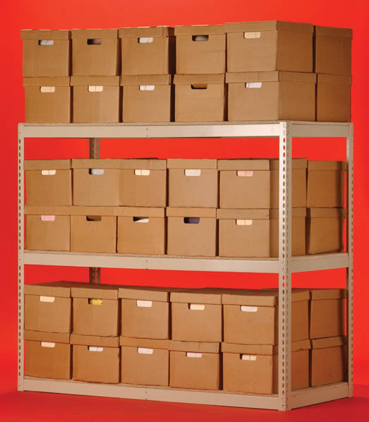
NPS Intermediaries
Central Record Keeping Agency (CRA)
Recordkeeping, Administration and customer service functions for all NPS subscribers.
Issue of unique Permanent Retirement Account Number (PRAN) to each subscriber.
Maintaining database of all PRANs issued and recording transactions relating to each subscriber’s PRAN.
Issuance of PRAN Transaction Statement.
Acting as an operational interface between PFRDA and other NPS intermediaries such as Pension Funds, Annuity Service Providers, Trustee Bank etc.
Central Record Keeping Agency
is
National Securities Depository Limited (NSDL)

Slide 9

NPS Intermediaries
Points of Presence (POP)
First point of interface between voluntary subscriber and NPS architecture
Provides NPS services to subscriber
  Subscriber Registration
  Regular subscriber’s contribution
  Change in subscriber details
  Change of investment scheme/fund manager
  Processing of withdrawal request
  Processing of request for subscriber shifting
  Issuance of printed Account statement
  Any other service prescribed by PFRDA
39 Organizations are selected by PFRDA to act as Point of Presence (POP)
Under NPS
List is provided in next slide

Slide 10
List of POPs (Alphabetical order)
Bank
Abhipra Capital Limited
Alankit Assignments Limited
Allahabad Bank
Andhra Bank
Axis Bank Ltd.
Bajaj Capital Ltd.
Bank of Baroda
Bank of India
Bank of Maharashtra
Canara Bank
Central Bank of India
Citibank N.A
Computer Age Management Services Pvt. Ltd.
Corporation Bank
Dena Bank
Elite Wealth Advisors Limited
HDFC Securities Limited
ICICI Bank Limited
ICICI Securities Ltd
IDBI Bank Limited
21. IL &FS Securities Services Ltd
22. India Infoline Finance Limited
23. India Post NPS Nodal Office
24. Indian Bank
25. Indian Overseas Bank
26. Integrated Securities Ltd
27. Karvy Financial Services Limited
28. Kotak Mahindra Bank Limited
29. Marwadi Shares and Finance Limited
30. Microsec Capital Limited
31. Muthoot Finance Limited
32. Oriental Bank of Commerce
33 Punjab and Sind Bank
34 Punjab National Bank
35 Reliance Capital Limited
36. State Bank of Bikaner and Jaipur
37. State Bank of Hyderabad
38. State Bank of India
39. State Bank of Indore
40.State Bank of Mysore
41. State Bank of Patiala

Slide 11
List of POPs Contd..(Alphabetical order)
42. State Bank of Travancore
43. Steel City Securities Ltd
44. Stock Holding Corporation Of India Ltd
45. Syndicate Bank
46. Tamilnad Mercantile Bank Ltd
47. The Federal Bank Ltd.
48. The Karur Vysya Bank
49. The Lakshmi Vilas Bank Limited
50. The South Indian Bank Ltd.
51. UCO Bank
Union Bank of India
United Bank of India
UTI Asset Management Company Limited
UTI Technology Services Ltd.
Vijaya Bank
Yes Bank Ltd
Zen Securities Limited

Slide 12

NPS Intermediaries
Trustee Bank (TB)
Collection of Funds from identified POP/POP-SP
Pooling of Funds at Trust Account at Nodal Branch. Fund Receipt Confirmation to CRA
Remittance of funds to PFMs, as per CRA
Fund Reconciliation with CRA
Trustee Bank
is
Bank of India (BOI)

Slide 13

NPS Intermediaries
Pension Fund Managers (PFM)
Performs the investment management functions under the NPS
PFMs invests strictly in accordance with guidelines issued by the PFRDA/NPS Trust
Provides daily NAV under NPS
Pension Fund Managers under Unorganized Sectors are:
ICICI Prudential Pension Funds Management Company Limited
Kotak Mahindra Pension Fund Limited
Reliance Capital Pension Fund Limited
SBI Pension Funds Limited
UTI Retirement Solutions Limited

Slide 14

NPS Intermediaries
Custodian
Providing Custodial services in compliance with SEBI Custodial Regulations 1996
  Settlement Processing of Assets
  Safe keeping of securities - Electronic
  Physical Custody of Securities
  Corporate Actions
Stock Holding Corporation of India (SCHIL)
Is
Custodian

Slide 15

NPS Intermediaries
Annuity Service Provider
Responsible for delivering a regular monthly pension against the accumulated NPS corpus to the subscriber.
Annuity Service Providers
under NPS
Bajaj Allianz Life Insurance Co. Ltd.
HDFC Life Insurance Co. Ltd
ICICI Prudential Life Insurance Co. Ltd.
Life Insurance Corporation of India
Reliance Life Insurance Co. Ltd.
SBI Life Insurance Co. Ltd.
Star Union Dai-ichi Life Insurance Co. Ltd.

Slide 16

Reach of NPS
National Pension System
Central Government
State Government
Unorganized
Sector
Corporate
Sector
NPS
Lite
PFRDA
NPS Trust
Central Record Keeping Agency
Common
Stakeholders
Trustee Bank
Pension Fund Managers
Custodian
PAO
Directorate/ DTO
POP/POP-SP
CHO/ CBO
Aggregator
Sector Specific
Stakeholders
CG Employee
SG Employee
Voluntary Subscriber
Corporate Underlying
Subscriber
Economically Disadvantaged Group
16

Slide 17

Key Features of NPS
Unbundled Architecture, where each function is performed by different entity.
NPS provides an opportunity for subscribers, to be serviced by intermediaries which are renowned in their area, that too at low cost
PFRDA, a Prudent Regulator created by Government of India.
Central Record keeping lies with NSDL which is associated in various National level projects for recordkeeping functions.
Renowned Financial Institutions covering Public/Private Sector Banks, NBFC, Broking houses acting as POP.
Funds are managed by funds managers from Public & Private sector with proven track record.
Bank of India, a nationalized bank with wide spread across India, functions as Trustee Bank.
Stock Holding Corporation of India Ltd, who introduced Custodial services in India, functions as custodian for NPS.

Slide 18
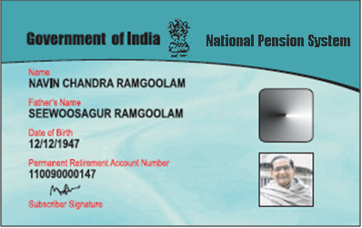
Key Features of NPS
Every individual subscriber is issued a Permanent Retirement Account Number (PRAN) card
12 digit unique number
Issued by Government of India, hence can be used as Identity Proof
In case lost/stolen, Provision of reprint of PRAN card on chargeable basis

Slide 19

Key Features of NPS
Complete portability of Permanent Retirement Account (PRA) with respect to geographies and employment
NPS account can be operated from anywhere in the country irrespective of employment and geography
Subscribers can shift from one sector to another
  For ex: A subscriber of Unorganised sector can move to Central Govt, State Govt etc with same Account
Subscriber can also shift within sector also like
  From one POP to another POP
  Within Same POP
    From one POP-SP to another POP-SP

Slide 20

Key Features of NPS
NPS is a fully transparent, web enabled, easy to understand system.
Secure web based interface provided to subscriber
Unique I-Pin allotted to subscriber, with periodical password changing policy
Subscriber can avail below services online:
  Can view Client master details and status of change detail requests
  Can generate Portfolio query
  Can view Transaction history showing
    Fund Manager
    Units Allotted
    NAV & Investment Value etc
  Request and print for Transaction Statement
  Can raise Grievances online against any intermediary

Slide 21

Key Features of NPS
Tax Treatment for NPS.
NPS is covered under the Income Tax Act, 1961 for tax benefits.
Currently NPS has ‘Exempt-Exempt-Taxation’ (EET) where
  Investment up to 1 Lakh in Tier I account is exempted
  Withdrawal are subject to tax
As per the Proposed Direct Tax Code (DTC), NPS will have Exempt-Exempt-Exempt (EEE) status
  All investments (Up to Rs.1 Lakh) made under Tier I account under NPS are exempted
  No tax at the time of withdrawal
There is no exemption on Investments made under Tier II account.

Slide 22

Key Features of NPS
Swavalamban Benefit
Announcement of Swavalamban scheme in the Union budget 2010-11
Government to contribute Rs.1000 to each NPS account provided
  Subscriber has given Swavalamban declaration
  Annual contribution is in the range 1000-12000
  Subscriber is not covered under any other social security schemes like PF, Pension etc
Recovery of Swavalamban benefits and penal interest from Subscriber in case subscriber gives false declaration

Slide 23


Investment option in NPS

Slide 24
Type of Accounts
Under NPS two types of accounts are available
Tier-I account:
Subscriber shall contribute his savings for retirement into Tier-I non-withdrawable account.
Tier-II account:
Voluntary savings facility.
Subscriber will be free to withdraw his savings from this account whenever he wishes.

Slide 25
Tier I Account
  Subscriber will make first contribution at the time of applying for registration with POP-SP.
  The subscriber has option to contribute anytime during the year as per his convenience.
Minimum Contribution at the time of account opening | Rs. 500
Minimum amount per contribution | Rs. 500
Minimum amount balance at the end of financial year | Rs. 6000
Minimum no. of contributions | 1 per year

Slide 26
Tier II Account
Tier II is a pension savings account, with a facility for withdrawal to meet financial contingencies
No Account Opening & Account Maintenance Charges by CRA
Only transactions are charged by CRA & POPs
No limit on withdrawals from Tier II account
Investment Patterns same as Tier I
Minimum Contribution at the time of account opening | Rs. 1000
Minimum amount per contribution | Rs. 250
Minimum amount balance at the end of financial year | Rs. 2000
Minimum no. of contributions | 1 per year

Slide 27
Investment Option in NPS
In NPS the Subscriber has the
Choice of Five Pension Funds
ICICI Prudential Pension Fund
Choice of Approach
Active Choice (Active Fund Management by Subscriber)
Kotak Mahindra Pension Fund
Reliance Capital Pension Fund
SBI Pension Fund
UTI Retirement Solutions Pension Fund
Auto Choice (Default scheme with a life cycle fund option)
Asset Class G: Government Securities
Asset Class C: Fixed Income
Asset Class E: Equity
Choice of Three Schemes

Slide 28
Asset Class E in UoS
Asset Class E: Investment in Equity Market Instruments
Objective – The investment objective is to maximise returns while investing in chosen index over a rolling annual basis.
The maximum one can invest in this asset class would be 50%.
The asset class will be further invested in index funds of a particular index such as BSE and NSE.
Investment in unlisted equity shares or equity related instruments is not allowed.
Investment in IPOs is not allowed.
The investment in any equity stock is limited a maximum of 10% of the issued capital of a company.
No investment in any unlisted security of an associate or group company is allowed.

Slide 29
Asset Class G in UoS
Asset Class G: Investment in Government Securities
Objective – The investment objective is to optimise risk free returns.
The asset class will be invested in Central Government and State Government Bonds.

Slide 30
Asset Class C in UoS
Asset Class C: Investment in Fixed Income Instruments
Objective – The investment objective is to provide optimum mix of risk and rewards.
Liquid Mutual Funds of AMCs regulated by SEBI.
Fixed Deposits of Scheduled Commercial Banks (SCBs) with networth of Rs. 500 crores, profitable for last 3 years and capital adequacy ration of over 9%.
Debt securities with maturity of not less than three years tenure issued by Bodies Corporate including SCBs and PFIs.
Credit Rated PFI/PSU Bonds.
Credit Rated Municipal Bonds/Infrastructure Bonds.
Bonds of Companies whom shares are listed in Stock Exchange.

Slide 31
Schemes / Investment Approach
NPS offers two approaches to invest subscriber money
Active choice - Individual Funds
(Asset class E, C, and G )
Auto choice –
Lifecycle Fund
Gives the subscriber right to decide as to how his contribution is to be invested
Where the subscriber doesn’t have financial knowledge, the contribution will be made in pre-defined portfolio

Slide 32
Approach 1: Active Choice
Subscriber have the option to actively decide as to how his NPS pension contribution is to be invested in the three options i.e.
Asset Class E - investments in predominantly equity market instruments
Asset Class C - investments in fixed income instruments other than Government securities
Asset Class G - investments in Government securities.

Slide 33
Some Scenarios of Active Choice
Investment in equity is limited to 50%
Choice of Investment | E (Equity) | C (Fixed Income) | G (Government Securities)
Active | 50% (max) | 25% | 25%
Active | 50% (max) | 30% | 20%
Active | 0% | 50% | 50%
Active | 0% | 100% | 0%
Active | 0% | 0% | 100%
Active | 30% | 30% | 40%
Active | 20% | 50% | 30%
Based on age, financial goals and risk appetite, subscriber can apportion his contribution in Asset class E, C & G.

Slide 34
Guidelines for Selecting Active
Choice
Higher the risk, higher the return and vice-versa.
  For example: the Asset class E has higher returns than the G asset class, but it also carries the risk of investment losses. Investing entirely in the asset class G may not give you high returns but is a safer option.
Diversify the investment and reduce the risk. One should distribute his contribution in all the three asset classes E, C and G.
Higher the investment time horizon, lower is the risk.
Periodically review the investment choices. Rebalance the allocation as per the age, financial goals and economy growth.

Slide 35
Approach 2: Auto Choice
Subscribers who do not have
    the financial and investment knowledge
    unable/unwilling to exercise any choice of investment,
    then their contribution can be invested in accordance with the Auto Choice option.
In this option, the investments will be made in a life-cycle fund.
The fraction of funds invested across three asset classes E, C & G will be determined by a pre-defined portfolio.

Slide 36
Auto Choice: Lifecycle Fund
At the lowest age of entry (18 years), the auto choice will entail investment of 50% of pension wealth in “E” Class, 30% in “C” Class and 20% in “G” Class.
The ratios of investment will remain fixed for all contributions until the subscriber reaches the age of 36.
From age 36 onwards, the weight in “E” and “C” asset class will decrease annually and the weight in “G” class will increase annually till it reaches 10% in “E”, 10% in “C” and 80% in “G” class at age 55.

Slide 37
Auto: Table for Life Cycle Fund
Age | Asset Class E | Asset Class C | Asset Class G
Up to 35 years | 50% | 30% | 20%
36 years | 48% | 29% | 23%
37 years | 46% | 28% | 26%
38 years | 44% | 27% | 29%
39 years | 42% | 26% | 32%
40 years | 40% | 25% | 35%
41 years | 38% | 24% | 38%
42 years | 36% | 23% | 41%
43 years | 34% | 22% | 44%
44 years | 32% | 21% | 47%
45 years | 30% | 20% | 50%
46 years | 28% | 19% | 53%
47 years | 26% | 18% | 56%
48 years | 24% | 17% | 59%
49 years | 22% | 16% | 62%
50 years | 20% | 15% | 65%
51 years | 18% | 14% | 68%
52 years | 16% | 13% | 71%
53 years | 14% | 12% | 74%
54 years | 12% | 11% | 77%
55 years | 10% | 10% | 80%
The Scheme endorse the subscriber investments and manages its risk exposure through auto balance.

Slide 38
Rebalancing Feature
When there is variation in Subscriber Corpus Allocation due to the NAV fluctuation, rebalancing needs to be done.
In case of Active Choice –
A cap of 50% on investment under Equity scheme is applicable. In case this limit is exceeded, rebalancing will need to be carried out once in a year on the date of the birth of subscriber.
In case of Auto Choice –
Dynamic (system driven) rebalancing across scheme as per the age wise allocation ratio will be carried out on the date of birth of the subscriber.

Slide 39
Example : Rebalancing Portfolio
On 15th May, 2010, due to the rise in NAV value from across various Schemes the exposure in Equity may go beyond the stipulated limit of 50% as decided by PFRDA.
After 1 Year of registration, NAV of the E, C & G Scheme as on 15th May 2010
Breach in Equity cap due to the increase in NAVs
Subscriber Statement of holding after the first contribution
The total percentage allocation under Equity scheme has cross the stipulated limit of 50% as imposed by PFRDA and as a result of which the entire subscriber corpus needs to be rebalanced to bring down the exposure to Equity to 50 %.

Slide 40

Contribution Payment

Slide 41
Contribution Amount - Tier I Account
Contribution payment for Tier I account:
Minimum Contribution at the time of account opening | Rs. 500
Minimum amount per contribution | Rs. 500
Minimum total contribution in the year | Rs. 6000
Minimum frequency of contributions | 1 per year
Our Understanding

Slide 42
Contribution Amount - Tier II Account
Contribution payment for Tier II account:
Minimum Contribution at the time of account opening | Rs. 1000
Minimum amount per contribution | Rs. 250
Minimum total contribution in the year | Rs. 2000
Minimum frequency of contributions | 1 per year

Slide 43

NPS Contribution Payment Process
Subscriber to approach any nearest POP-SP branch for contribution payment
Payment modes available –
  Cash
  Cheque –
    Post dated cheques acceptable
    Outstation cheques not acceptable
  Demand draft
  Electronic Clearing Service (ECS): If facility is provided by POP

Slide 44
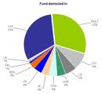
Charge Structure in NPS

Slide 45
Charge Structure
Intermediary | Charge head | Service Charges* | Method of Deduction
CRA | PRA Opening charges | Rs. 50 | Through cancellation of units
 | Annual PRA Maintenance cost per account | Rs. 225
 | Charge per transaction | Rs. 5
POP (Maximum Permissible Charge for each subscriber) | Initial subscriber registration and contribution upload | Rs. 40 | To be collected upfront
 | Any subsequent transactions | Rs. 20
Trustee Bank | Per transaction emanating from a RBI location | Zero | Through NAV deduction
 | Per transaction emanating from a non-RBI location | Rs. 15
Custodian (On asset value in custody) | Asset Servicing charges | 0.0075% p.a for Electronic segment & 0.05% p.a. for Physical segment | Through NAV deduction
PFM charges | Investment Management Fee | 0.0009% p.a. | Through NAV deduction
*Service tax and other levies, as applicable, will be levied as per the existing tax laws.

Slide 46
Net Investment in NPS – Tier 1
NPS Premium (A) | Year | POP Charge* (B) | Net Invested Premium (C) | CRA Charges ** (D) | PFM Charge (E) | Custodian Charge+ (F) | Total Charges (G=D+E+F) | Net Premium Value (H=C-G)
6,000 | First Year | 110.3 | 5,890 | 390.462 | 0.0546 | 0.4549 | 391 | 5,499
 | Subsequent Year | 88.24 | 5,912 | 335.312 | 0.0554 | 0.4613 | 336 | 5,576
10,000 | First Year | 110.3 | 9,890 | 390.462 | 0.0943 | 0.7858 | 391 | 9,498
 | Subsequent Year | 88.24 | 9,912 | 335.312 | 0.0951 | 0.7922 | 336 | 9,576
25,000 | First Year | 110.3 | 24,890 | 390.462 | 0.2432 | 2.0267 | 393 | 24,497
 | Subsequent Year | 88.24 | 24,912 | 335.312 | 0.2440 | 2.0331 | 338 | 24,574
50,000 | First Year | 110.3 | 49,890 | 390.462 | 0.4914 | 4.0948 | 395 | 49,495
 | Subsequent Year | 88.24 | 49,912 | 335.312 | 0.4921 | 4.1012 | 340 | 49,572
1,00,000 | First Year | 110.3 | 99,890 | 390.462 | 0.9877 | 8.2310 | 400 | 99,490
 | Subsequent Year | 88.24 | 99,912 | 335.312 | 0.9885 | 8.2374 | 345 | 99,567
CRA account maintenance and transaction charges will reduce once subscriber base touches 30 lacs.
Charges are fixed and not vary with the corpus size
*POP charges includes minimum number of 4 contribution/year. Initial Registration =Rs 20, Per Contribution = Rs 20
** CRA charges include Rs 6 per transaction and Rs 280 for annual maintenance. First Year registration charge is Rs 50.
+ Custodian Charges calculated for Electronic Segment (0.0075%) .
All charges include Service tax of 10.3%

Slide 47
Net Investment in NPS – Tier 2
Tier II Contribution (A) | Year | POP Charge* (B) | Net Invested Premium (C) | CRA Charges ** (D) | PFM Charge (E) | Custodian Charge+ (F) | Total Charges (G=D+E+F) | Net Premium Value (H=C-G)
2000 | First Year | 88.24 | 1,912 | 26.472 | 0.0187 | 0.1560 | 26.65 | 1,885
 | Subsequent Year | 88.24 | 1,912 | 26.472 | 0.0187 | 0.1560 | 26.65 | 1,885
10000 | First Year | 88.24 | 9,912 | 26.472 | 0.0981 | 0.8178 | 27.39 | 9,884
 | Subsequent Year | 88.24 | 9,912 | 26.472 | 0.0981 | 0.8178 | 27.39 | 9,884
25000 | First Year | 88.24 | 24,912 | 26.472 | 0.2470 | 2.0586 | 28.78 | 24,883
 | Subsequent Year | 88.24 | 24,912 | 26.472 | 0.2470 | 2.0586 | 28.78 | 24,883
50000 | First Year | 88.24 | 49,912 | 26.472 | 0.4952 | 4.1267 | 31.09 | 49,881
 | Subsequent Year | 88.24 | 49,912 | 26.472 | 0.4952 | 4.1267 | 31.09 | 49,881
100000 | First Year | 88.24 | 99,912 | 26.472 | 0.9916 | 8.2629 | 35.73 | 99,876
 | Subsequent Year | 88.24 | 99,912 | 26.472 | 0.9916 | 8.2629 | 35.73 | 99,876
No separate AMC charges applicable on investments.
*POP charges assumes minimum number of contribution i.e. 4 per year. Charges per Contribution = Rs 20
** CRA charges include Rs 6 per transaction only, hence net CRA charges = Rs 24+10.3% (service tax).
+ Custodian Charges calculated for Electronic Segment (0.0075%) .
All charges include Service tax of 10.3%

Slide 48
Comparison of Charges
Investment Illustration for Annual Contribution of Rs 1,00,000 in Comparable Products
Product | Year | Premium Allocation Charge* (B) | Net Invested Premium (C) | Policy Admin Charges ** (D) | Fund Mngmnt Charge (E) | Total Charges (G=D+E) | Net Premium Value (H=C-G)
NPS | First Year | 100 | 99,900 | 354.00 | 0.0009% | 391.45 | 99,508
 | Subsequent Year | 80 | 99,920 | 304.00 | 0.0009% | 336.30 | 99,584
Unit Linked Pension | First Year | 8000 | 92,000 | 5519.99 | 1% | 7103.31 | 84,897
 | Subsequent Year (Max till 5 years) | 2000 | 98,000 | 5879.99 | 1% | 7566.57 | 90,433
Mutual Fund | First Year | 0 | 100,000 | 0.00 | 2.50% | 2757.50 | 97,242
 | Subsequent Year | 0 | 100,000 | 0.00 | 2.50% | 2757.50 | 97,242
Lowest charge structure with NPS gets maximum fund invested for investor
Premium Allocation Charge (B)
  NPS is Rs 20 initial registration and Rs 20*4 for minimum four contributions.
  ULPP has 8% allocation charge. This can be 4% till first five years.
  Mutual Fund: No allocation charge.
Policy Administration Charge (D)
  NPS: Includes CRA charge of Rs 50 in first year for registration and Rs 280 every year for annual maintenance.
  ULPP: Assumes 0.5% of annual premium per month
  Mutual Fund: None
Fund Management Charge (E)
  NPS: It is 0.0009% every year
  ULPP: Varies. Here assumed at 1% every year
  Mutual Fund: Here assumed at 1.5% every year
Service tax =10.3% for all charges.

Slide 49
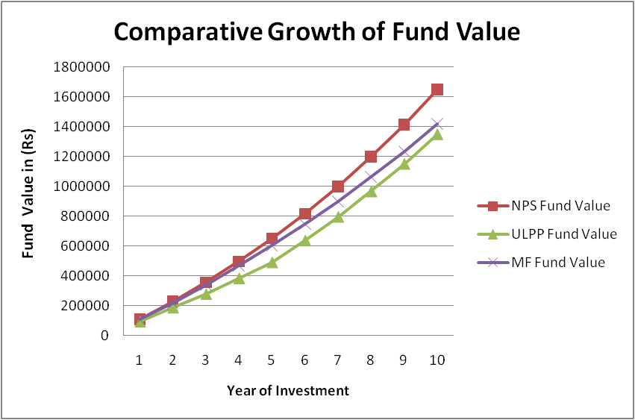
Comparison of Fund Growth
Growth of Fund value @ 9% for Annual Contribution of Rs 1,00,000 in Comparable Products
 | NPS |  |  |  | Unit Linked Pension Plan |  |  |  | Mutual Fund
Year | Premium Allocation Charge | Admin Charge | FMC | Fund Value | Premium Allocation Charge | Admin Charge | FMC | Fund Value | Premium Allocation Charge | Admin Charge | FMC | Fund Value
1 | 100 | 354 | 0.0009% | 108504 | 8% | 6% | 1% | 92650 | 0 | 0 | 2.5% | 106275
2 | 80 | 304 | 0.0009% | 226849 | 4% | 6% | 1% | 186890 | 0 | 0 | 2.5% | 219219
3 | 80 | 304 | 0.0009% | 355844 | 4% | 6% | 1% | 278312 | 0 | 0 | 2.5% | 339250
4 | 80 | 304 | 0.0009% | 496446 | 0 | 6% | 1% | 383495 | 0 | 0 | 2.5% | 466813
5 | 80 | 304 | 0.0009% | 649702 | 0 | 6% | 1% | 490119 | 0 | 0 | 2.5% | 602380
6 | 80 | 304 | 0.0009% | 816750 | 0 | 0 | 1% | 636797 | 0 | 0 | 2.5% | 746455
7 | 80 | 304 | 0.0009% | 998829 | 0 | 0 | 1% | 795078 | 0 | 0 | 2.5% | 899570
8 | 80 | 304 | 0.0009% | 1197295 | 0 | 0 | 1% | 965878 | 0 | 0 | 2.5% | 1062293
9 | 80 | 304 | 0.0009% | 1413620 | 0 | 0 | 1% | 1150189 | 0 | 0 | 2.5% | 1235226
10 | 80 | 304 | 0.0009% | 1649412 | 0 | 0 | 1% | 1349079 | 0 | 0 | 2.5% | 1419012

Slide 50

Fund Security

Slide 51

Government Initiative
NPS is mandatory for all new entrants joining Central Government Service.
25 State Governments/UTs have notified the NPS in their respective jurisdictions.
19 State Governments have signed the agreements with CRA for recordkeeping and administration
Of these, 18 States have signed agreements with the NPS Trust for pension fund and custodial arrangements (Haryana, MP, AP, Jharkhand, Chhattisgarh, Gujarat, Pondicherry, Uttarakhand, Assam).
Approximately 6,67,225 and 3,79,506 subscribers are now registered with the CRA (NSDL) from Central and State Governments respectively.

Slide 52

PFRDA - Profile
Pension Fund Regulatory and Development Authority (PFRDA) has been established by the Government of India, Ministry of Finance to promote old age income security through NPS.
Architect of NPS features.
Appointment of entities of NPS architecture.
Regulate and monitor the performances of the entities like PFMs, CRA, NPS Trust, Trustee bank etc.

Slide 53

NPS Trust - Profile
PFRDA has established the NPS Trust under Indian Trust Act, 1882 and appointed NPS Board of Trustees in whom the administration of the “New Pension System” vests under Indian Law.
The Trust is responsible for taking care of the funds under the NPS.
The Trust holds an account with the Bank of India and this bank is designated as the NPS Trustee Bank.

Slide 54
PFM - Profile
Sponsors of the Pension Fund are either a Central or State Govt. company, Central Public Financial Institution, Scheduled Commercial Bank, Insurance Company or Asset Management Company (AMC) regulated by RBI, SEBI or IRDA.
Sponsors of the Pension Fund have
    minimum 5 years experience of Fund Management,
    monthly average AUM of not less than Rs.8000 crores,
    minimum positive net worth of Rs.10 crores.
The Pension Funds are incorporated as a Separate Company under Company Act 1956, with direct or indirect FDI not exceeding 26% of the paid up share capital.

Slide 55
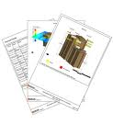
Monitoring Compliance
Compliance with disclosure requirements and the Code of Conduct specified by PFRDA from time to time.
Management of Pension Funds in line with the Investment Management Agreement signed with the NPS Trust .
Pension fund maintains their separate accounts and audits are conducted by agency appointed by PFRDA.
The audit agency checks the NAV calculation procedure and computation of other charges on subscriber.
Periodic reporting and Performance Review by PFRDA/NPS Trust.

Slide 56
Measuring PFM Performance-Monthly
S. No | Report / Content
1 | Details of the Portfolio Value for each scheme.
2 | A calculation of the total percentage return (money and time weighted) on the Portfolio for each scheme for the period.
3 | A subdivision of Portfolio Value into each type of security showing market value in rupees and as a percentage of total Portfolio Value.
4 | Details for each investment in the Portfolio including (as per Details column) Name of investment, Number of units (eg shares = number of shares, bonds = face value); Carrying value of investment, Market value per unit
5 | Details of all transactions effected by the Manager during the period.
6 | Amounts received or accrued during the period to which the report relates.
7 | The management fee (included in the monthly report at the quarter end)

Slide 57
Measuring PFM Performance -Quarterly
S. No | Report / Content
1 | Overview of portfolio positioning including evaluation of current economic conditions, prospects for securities markets, justification for the positions and transactions in the portfolio, attribution of performance over last quarter (and year when applicable) on absolute basis as well as relative to the specified market benchmark, outlook for returns for the portfolio.
2 | All transactions carried out between the schemes, PF and its associates or purchase/sale of securities of group companies of sponsor.
3 | All transactions in securities by key personnel of PF in their own beneficial interest (either in own name or through associates).
4 | Internal audit reports from independent auditors, compliance certificates and subscriber complaints reports
5 | Statement of compliance with investment guidelines

Slide 58
Measuring PFM Performance - Yearly
S. No | Report / Content
1 | Statement regarding the current status of the sponsor’s regulatory licenses and details of any changes in the name or capitalisation of the PF company or sponsors.
2 | Statement of income and expenditure and a balance sheet reflecting the position of the funds, investments made, and a statement showing the amount of interest accrued but not realised as on closing date of the financial year.
3 | All service contracts carried out between schemes, PF & its associates.
4 | All service contracts such as for custody arrangements and transfer agency of the securities are executed in the interest of subscribers.
5 | Summary of all activities and compliance with guidelines.
6 | Annual statement of audited accounts of the scheme.

Slide 59

Risk Management
Option to remain invested even after retirement.
  Unlike other pension plans NPS gives subscriber an option to remain invested in the scheme even after the age of retirement.
50% cap on equity with rebalancing feature.
  To protect the subscribers contribution, investment in equity is limited to 50%.
Auto choice option.
  Where the subscriber doesn’t have financial knowledge, the contribution will be made in pre-defined portfolio.
Option to switch PFM & change asset allocation ratio.
  Subscriber has option to change PFM if he is not satisfied with the performance of fund, charge structure, quality of service etc.
  Subscriber has option to revise the asset allocation ratio based on age and financial goals.

Slide 60


Annuity Selection

Slide 61
Annuity in NPS
Annuity is the fixed monthly (periodic) income which a subscriber will get against the corpus invested.
The larger the corpus size, bigger the annuity.
In case of normal retirement, subscriber can annuities a minimum of 40% and maximum of 100 % of his corpus towards buying annuity.
NPS provides an option to the subscriber to decide his retirement age which can be anytime before 60. In such case subscriber can annuities a minimum of 80% and maximum of 100 % of his corpus towards buying annuity.
At the time of exit the subscriber will have an option to purchase annuity online.

Slide 62
Annuity Selection
Subscriber would be given the following online facilities –
  Selection of Annuity Service Provider (ASP).
  Selection of annuity scheme.
  Option to change ASP & scheme (if already registered) before attaining retirement age.
  The entire transfer of amount between NPS System and ASP will take without any manual intervention.
ASP to be regulated by IRDA.

Slide 63

Getting your money out of NPS

Slide 64
Types of Withdrawal
Normal Retirement
Pre mature Retirement
Conditions for Withdrawal
Death of subscriber

Slide 65

Withdrawal Process
TB transfers settlement amount on T+3 day into subscribers bank account or give cheque
Trustee Bank
POP Branch
CRA
Submits withdrawal form along with relevant Docs
Sends instructions
Transfers settlement amount online
Maker
Checker
Pension Fund Manager
Subscribers / Nominee
POP process withdrawal request online in CRA system through maker-checker process.
Executes request received from POP
CRA sends withdrawal instructions online to Trustee Bank & PFM
On receipt of CRA instructions, PFM as per T+3 day’s NAV calculates and transfers money to TB
T = POP authorizes withdrawal request
Assumption: Annuity Service Provider (ASP) and scheme already selected by subscriber

Slide 66
Normal Withdrawal
Normal retirement – On attaining age of 60 years
Procedure
Subscriber to submit withdrawal form to POPs
Documents required
PRAN card
Timelines
Subscriber receives settlement amount of lump sum 60% on T*+ 3 days directly into bank account or through cheque
Remaining min. 40% or above goes to ASP online on T*+3 days
Annuitize min. 40% of pension wealth and withdraw 60% as lump sum or in phased manner
Copy of PRAN card
Withdrawal form
T*=date of withdrawal request authorized by POP in CRA system

Slide 67
Premature Withdrawal
Incase of premature retirement – At any point in time before 60 years of age
Procedure
Subscriber to submit withdrawal form to POP
Documents required
PRAN card
Timelines
Subscriber receives settlement amount of lump sum 20% on T*+ 3 days directly into bank account or through cheque
Annuitize min. 80% of pension wealth and withdraw 20% as lump sum or in phased manner
Copy of PRAN card
Withdrawal form
Remaining min. 80% or above goes to ASP online on T*+3 days
T*= date of withdrawal request authorized by POP in CRA system

Slide 68
Withdrawal in case of death
Incase of death due to any cause– If Nominee exists
Procedure
Nominee submits withdrawal form to POP
Documents required
Death certificate of the deceased
Timelines
Nominee receives lump sum settlement amount in T*+ 3 days directly into bank account or through cheque
Identification proof of the nominee
T*= date of withdrawal request authorized by POP in CRA system

Slide 69
Withdrawal in case of death
Incase of death due to any cause– If Nominee does not exist
Procedure
Legal heir to the deceased submits withdrawal form to POPs
Documents required
Death certificate
Timelines
Legal heir receives lump sum settlement amount in T*+ 3 days directly into bank account or through cheque
Identification proof of the legal heir
Legal heir certificate as applicable by Court of Law
T*= date of withdrawal request authorized by POP in CRA system

Slide 70
Deferred Withdrawal
On attaining Normal Retirement age of 60 years, subscriber is required to invest minimum 40% of his/her accumulated savings (pension wealth) to purchase a life annuity from any IRDA-regulated life insurance company
The remaining pension wealth can be withdrawn as lump sum at any point of time before the age of 70.

Slide 71

Return Illustrations

Slide 72
Return Illustration - @ 7% Growth*
What do you pay - Monthly Contribution (Rs.) | How long you pay - Investment Period
 | 10 years | 20 years | 30 years | 40 years
 | What you get - Monthly Pension Returns (in Rs.)
500 | 423 | 1,317 | 3,073 | 6,529
1,000 | 847 | 2,633 | 6,147 | 13,059
2,000 | 1,694 | 5,266 | 12,294 | 26,118
* Benefits are variable with returns based on future performance of the Investment Funds managed by PFMs. For the purpose of this illustration, we have used 7% as growth rate of investment return in the calculations.
Other Assumption
Return from any of the asset allocation E, C, and G is taken as 7% both during investment and retirement period
Subscriber would annuitize 100% pension corpus on retirement
Subscriber would receive monthly pension returns as per Life Annuity plan
Notes:
Need to check good calculator

Slide 73
Statement of Transaction
Statement of Transaction (SoT) is sent by CRA to all subscribers between April and June for all transactions done in previous financial year.
Alternatively, subscribers can get their SoT by the following ways:
Login to CRA site and view SoT
Visit PoP and request for SoT print out for a charge up to Rs 20 (taxes extra)

Slide 74
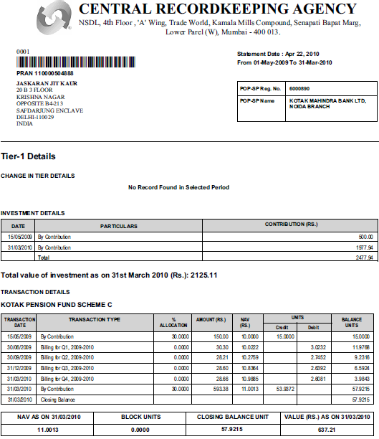
Subscriber’s Account Details
Subscriber’s POP SP Details
Subscriber’s contribution in last financial year
Name of Scheme and % allocation
Net Asset Value and Unit details on day of transaction
Date on which any transaction (Contribution payment, charge deduction, unit allocation etc.) tales place

Slide 75
NPS Returns for Year 2009-10
 | Absolute Return | Annualised Return | Annualised Return
Scheme Name → | Scheme E since Inception (May 1, 2009) | Scheme C since Inception (May 1, 2009) | Scheme G since Inception (May 1, 2009)
Name of PFM ↓
ICICI | 22.50% | 11.00% | 4.90%
Kotak | 14.30% | 11.00% | 3.80%
Reliance | 21.20% | 5.00% | 2.90%
SBI | 8.00% | 10.90% | 11.00%
UTI | 25.90% | 4.40% | 2.00%
Category Average | 19.23% | 8.85% | 4.55%
An Investor up to age of 35 years and with Auto Choice approach have got
annualized returns of 13.2%

Slide 76

Grievance Management

Slide 77

Introduction to Central Grievance
Management System (CGMS)
Central Grievance Management System (CGMS) is the platform to register grievances for all entities in CRA system.
A UoS subscriber can raise grievances against
    CRA for services provided by CRA and
    POP/ POP-SP.

Slide 78

Key Features of CGMS
Centralized and transparent platform for grievance resolution.
Stipulated timeframe to resolve grievance.
Unresolved grievance gets escalated.
Email alert sent to concerned entity on resolution/ escalation.
Centrally monitored by PFRDA.

Slide 79

Modes of Raising Grievance
Call Centre/Interactive Voice Response System (IVR)
The Subscriber can contact the CRA call centre at toll free telephone number 1-800-222080 and register the grievance.
Dedicated Call centre executives.
Physical forms direct to CRA
The Subscriber may submit the grievance in a prescribed format to the POP – SP who would forward it to CRA Central Grievance Management System (CGMS).
Subscriber can directly send form to CRA.
Web based interface
The Subscriber may register the grievance at the website www.npscra.nsdl.co.in with the use of the I-pin allotted at the time of opening a Permanent Retirement Account.

Slide 80
Grievance Management Process
Status through website/email/IVR/call centre
Entity Raising the Grievance
Logging / Digitization of grievance
CGMS
DATABASE
Intimation of
Ticket no.
Resolution
Yes
No
Through e-mail
Intimation
of resolution
Escalation

Slide 81

Escalation Mechanism
CGMS has automatic and manual escalation mechanism for monitoring the status of the grievance.
Maker-Checker concept in case of resolution of all the 'Escalated Grievances‘
If the subscriber does not receive any response within 30 days or are not satisfied with the resolution by CRA, he can apply to the Grievance Redressal Cell (GRC) of PFRDA.
There will three (3) levels of resolution, namely L1, L2 and L3 for Grievances raised against CRA.
    L1 will be the initial level for grievance received.
    L2 will be the second level of resolution with 1st level of escalation.
    L3 will be the specialized and unified grievance resolving team and with 2nd level of escalation.

Slide 82

Some Example of Grievances
Incorrect PRAN account details (on registration).
Statement of Transaction not received.
Change request updated incorrectly.
Change request given but not updated in account.
Switch instruction executed incorrectly.
Switch instruction not executed.
Delay in executing switch instruction.
T-Pin/I-Pin not received.
Request for duplicate PRAN card not initiated.
Request for I-Pin/T-Pin reissue not initiated.
Contribution amount not reflected in account.
Incorrect contribution amount reflected.

Slide 83
How to Subscribe in NPS

Slide 84
Whom to approach
To distribute NPS, PFRDA has appointed –
  58 entities to function as Points of Presence (POPs)
  29000+ Points of Presence-Service Provider (POP-SPs) branches
  List of POP-SPs available at
PFRDA website
CRA website
www.npscra.nsdl.co.in
www.pfrda.org.in

Slide 85
Eligibility Criteria in NPS
NPS Eligibility Criteria
Tier I Account | Tier II Account
Entry Age - Min: 18 years; Max:60 years | Any subscriber who has an active “Tier I” account under NPS can open Tier II Account
Subscriber should be an Indian Citizen
Subscriber should comply with the Know Your Customer (KYC) norms as detailed in the subscriber registration form
Subscriber should not be holding any pre-existing account under NPS

Slide 86
NPS Registration Form
Subscriber registration forms availability –
  Forms available at the nearest POP & POP-SP branch
  Online – www.npscra.nsdl.co.in
  Types of forms –
Composite Application Form (CAF) (For Tier I & II both) - UOS-S1
Tier II application for IRA Compliant Subscribers – UOS-S10
Tier II application for Non-IRA Compliant Subscribers – UOS-S11

Slide 87
Know Your Customer Docs
KYC documents to be mandatorily submitted
  Proof of identity (Copy of any one)
Passport issued by GOI
Ration Card with Photographs
Bank pass book or certificate with photograph
Voters Identity card with the photograph and residential address
Aadhar Card / letter issued by Unique Identification Authority of India.
Job cards issued by NREGA duly signed by an officer of the state Government.
Photo identity card issued by government, defense, paramilitary and Police Departments
Valid Driving License with Photograph
PAN Card issued by Income tax department
Certificate of identity signed by a Member of Parliament or Member of Legislative Assembly.
Ex – service Man Card issued by Ministry of Defense to their employees
Photo credit card.
Note: Subscriber is required to bring original documents & two self-attested photocopies (Originals will be returned over-the-counter after verification)

Slide 88
Know Your Customer Docs
KYC documents to be mandatorily submitted Address proof (Copy of any one)
Passport issued by GOI
Ration Card with Photographs
Bank pass book or certificate with photograph
Voters Identity card with the photograph and residential address
Valid Driving License with Photograph and residential address.
Letter from any recognised public authority at the level of gazetted officer like District Magistrate, Divisional Commissioner, BDDO, Tehsildar, Mandal revenue officer, Judical Magistrate
Certificate of address with photograph signed by a Member of Parliament or Member of Legislative Assembly.
Aadhar Card / letter issued by Unique Identification Authority of India clearly showing the address
Job cards issued by NREGA duly signed by an officer of the state Government
Latest Electricity / Water Bill in the name of the subscriber/ claimaint and showing the address (less than 6 months old)
Latest Telephone bill in the name of the subscriber/ claimaint and showing the address (less than 6 months old)
Latest property / house tax receipt (not more than 1 year old)
Existing valid registered lease agreement of the house on stamp paper (incase of rented / leased accommodation)
Note: 1) Proof of Address mentioned in Sr. No. 1 to 7 should not be more than six months old on the date of application.
2) You are required to bring original documents & two self-attested photocopies (Originals will be returned over-the-counter after verification)

Slide 89

Know Your Customer Docs
KYC documents to be mandatorily can be submitted as
date of birth proof:
  Passport
  Voter’s Identity Card
  Driving License
  PAN Card
  Matriculation Certificate

Slide 90

Enrollment Procedure
Procedure for registration in NPS
  Fill up the mandatory fields on the Subscriber registration form.
  Submit KYC documents supporting Proof of identity, address and date of birth.
  Submission of form to the POP-SP.
  Subscriber to make first contribution with a minimum amount of Rs. 500 for Tier I & Rs. 1000 for Tier II account.
  Issuance of receipt number by POP-SP as acknowledgement to subscriber to track the status of application.

Slide 91
Enrollment in NPS
  Procedure (Contd.)
    In case of CAF, generation of PRAN by CRA and dispatch of PRAN kit and I-Pin/T-Pin to the subscriber by CRA
  In case of only Tier II account, POP/POP-SP capture Tier II details online in CRA system and activates the Tier II account.
  Time frame for PRAN Generation
    PRAN Generation
    Dispatch of PRAN kit
Then Regular Contribution……
Then Regular Contribution……
within 7 to 10 days of receipt of application form by CRA
Within 20 days of submission of application form to POP/POP-SP

Slide 92

Timelines in NPS (Registration and Investment)

Slide 93
Timelines for Subscriber Registration Process
Process
Underlying activities
Timelines
Form Verification
KYC
Verification of NCIS slip & first contribution
Issuance of Receipt
MIS Upload in CRA system
1
Acceptance of Forms by POP-SP
Same Day
(T)
Submission of forms & KYC documents to CRA/CRA-FC
Covering letter
List of receipt number in duplicate
Deliver by hand/courier forms to nearest CRA-FC/CRA
Same Day (T)
to
Next Day (T+1)
2
Intimation of PRAN generation to PoP by CRA through email or Incremental PRAN master downloadable file
Dispatch of PRAN kit and IPIN/TPIN to subscriber by CRA
PRAN intimation to POP as and when PRAN is generated by CRA. Max. timeframe for PRAN generation is T+7 to T+10 days. Dispatch of PRAN kit within T+15 days
PRAN Generation & dispatch of PRAN kit by CRA
3
T = Date of Receipt of form by POP/POP-SP

Slide 94
Timelines for First Contribution Process
Process
Underlying activities
Timelines
PRAN intimation to POP & Clearing of non-cash instruments by POP/POP-SP
Put non-cash instruments for clearing
Issuance of Receipt
MIS upload in CRA system
Same day on which the PRAN generation intimation is received by POP/PoP-SP
(T) day
1
Preparation of SCF for Clear funds by POP/POP-SP
Use FPU & FVU Validations
T (By EOD) in case of cash contribution
Or
T+X (X=Time taken for clear funds) for non cash
2
POP/POP-SP remits Subscriber contribution to Trustee Bank
CSF to be submitted along with the subscriber contribution amount to the Trustee Bank.
(T +1) for cash contribution
Or
(T+X)+1 for non Cash contributions
3
T = Date of Intimation of PRAN generation to POP/POP-SP by CRA

Slide 95
Timelines for Regular Contribution Process
Process
Underlying activities
Timelines
Clearing of non-cash instruments by POP/POP-SP
Issuance of Receipt
MIS upload in CRA system
1
Same day
(T)
T (By EOD) in case of cash contribution
Or
T+X (X=Time taken for clear funds) for non cash
Preparation of SCF for Clear funds by POP/POP-SP
Use FPU & FVU Validations
2
POP/POP-SP remit Subscriber contribution to Trustee Bank
CSF to be submitted along with the subscriber contribution amount to the Trustee Bank.
(T +1) for cash contribution
Or
(T+X)+1 for non Cash contributions
3
T = Date when contribution is submitted by subscriber at PoP/POP-SP

Slide 96
Timelines for Fund Investment Process
Process
Underlying activities
Timelines
TB accepts the contribution only when CSF is submitted along with the money
TB to verify the amount as per CSF
TB returns the counter foil of form to POP-SP
(T +1) for cash contribution
Or
(T+X)+1 for non Cash contributions
1
Receipt of funds to TB by POP/POP-SP
(T +3) for cash contribution
Or
(T+X)+3 for non Cash contributions
2
TB upload FRC in CRA system
Consolidate & upload FRC
3
M&B process takes place in CRA system
SCF & FRC M&B process happens
Pay-in process takes place
Throughout the day between BOD & EOD
4
TB remits funds to PFMs on instruction from CRA
Download Pay-in instruction file from CRA system
Transfer funds to PFMs as per CRA’s instructions
(T +4) for cash contribution
Or
(T+X)+4 for non Cash contributions
T = Date when contribution is submitted by subscriber at POP
X = Time taken for clear funds

Slide 97
NAV’s Applicability
Process
Underlying activities
Timelines
Receive fund investment / settlement instructions from CRA
(T +4) for cash contribution
Or
(T+X)+4 for non Cash contributions
1
PFM receives funds from TB
Invests in market as per CRA’s instructions
Declares NAV (As per cut off)
2
PFM invests money in market & Declare day’s NAV
Same day of funds receive from TB
CRA divides total number of units and credit units into subscribers IRA accounts
EOD of (T +4) for cash contribution
Or
EOD of (T+X)+4 for non Cash contributions
3
Units credited into IRA’s
T
T = Date when contribution is submitted by subscriber at POP
X = Time taken for clear funds

Slide 98
Escalation Timelines
Grievances Logged by Subscriber against CRA will be escalated, if it is pending for more than two days (since base line performance is 2 days).
The grievances against a PoP/PoP-SP raised by the subscriber shall be resolved within 7 days of receiving of grievance. PoP-SP has three days to resolve and in case there is no resolution, then it is escalated to PoP who has four days to provide resolution.
Grievances Logged by PFM, Trustee Bank and Annuity Providers, will be considered as an escalated grievance.
CRA system will auto escalate grievances to higher levels if pending resolution for more than stipulated period.

Slide 99
NPS Operating Guidelines -
PoP-PoP (SP)

Slide 100
Roles and Responsibilities
PoP/PoP-SP are the first point of interaction between the subscriber and the NPS. The activities as part of their defined roles and responsibilities in the NPS are:
Subscriber Registration for Tier I as well as Tier II account.
Regular Subscriber Contribution Uploading
Subscriber Servicing
Grievance Handling, and
MIS Uploading

Slide 101
Subscriber Registration
PoP/PoP-SP shall facilitate the registration of the subscriber for Tier I and Tier II account. The steps involved in the registration process are:
Acceptance of forms
Accept only duly filed forms like UOS-S1, UOS-S10, UOS-S11
Verification of forms
Signed and complete form with DoB, bank, nomination, scheme details etc
Verify Know Your Customer (KYC) documents as per the norms prescribed
Processing of forms
submit all accepted application forms (including supporting documents) on daily basis, to CRA/CRA-Facilitation Centre (FC) for digitization by hand where the PoP-SP and the CRA-FC are co-located or transmit to CRA in Mumbai by post
Initial Contribution Processing at the Time of Registration:
collect duly filled NPS Contribution Instruction Slip (NCIS) along with the application form and ensure all the relevant details are provided in NCIS by the Subscriber.
remit the clear funds, after deducting its charges and applicable tax, to the Trustee Bank on T+1 basis for the corresponding PRAN of the subscriber
retain the ‘NCIS’ and other transaction related documents with itself

Slide 102
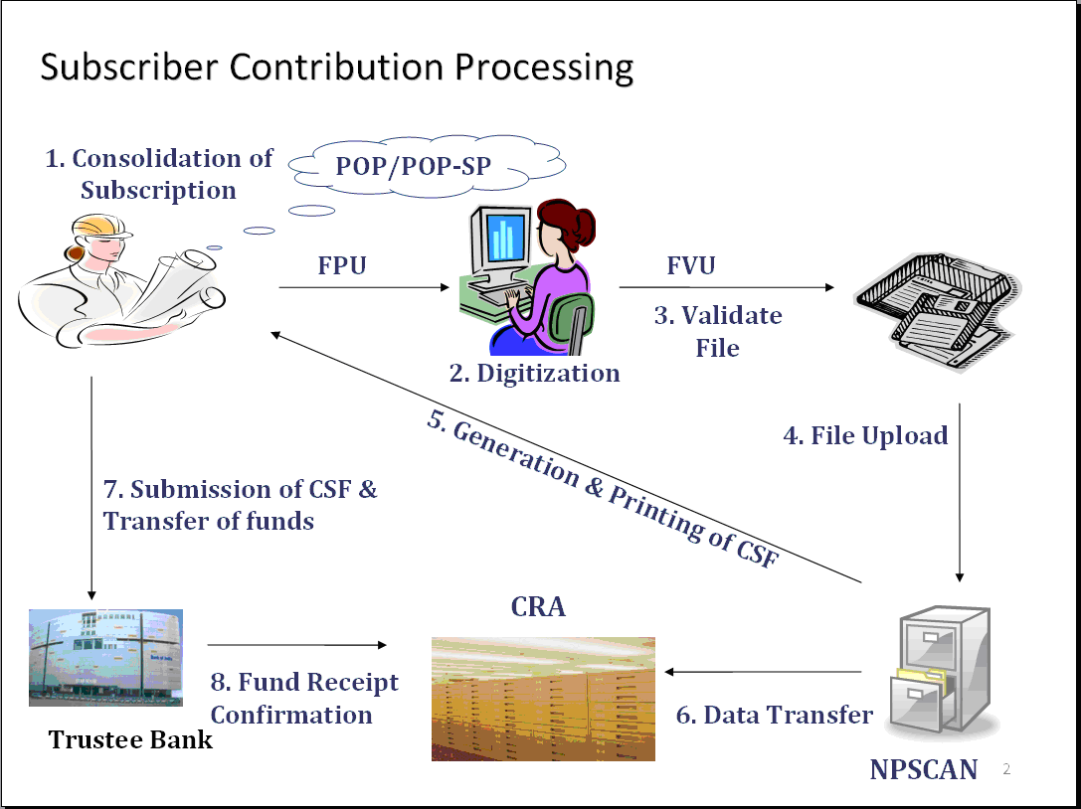
Regular Contribution Upload
PoP/PoP-SP shall perform all due diligence in accepting NCIS from subscriber and will check for PRAN no., Name, Payment details etc.
Upload subscriber contribution details online into the CRA system.
Remit the clear funds, after deducting its charges and applicable tax, to the Trustee Bank on T+1 basis for the corresponding PRAN of the subscriber. (T: date of receipt of clear funds)

Slide 103
Subscriber Servicing
Provides NPS services to subscriber
  Subscriber Registration
  Regular subscriber’s contribution
  Change in subscriber details
  Change of investment scheme/fund manager
  Processing of withdrawal request
  Processing of request for subscriber shifting
  Issuance of printed Account statement
  Attend request from subscriber for the re-issue of i-pin , t-pin , PRAN card
  Any other service prescribed by PFRDA

Slide 104
Grievance Handling
Activities carried by PoP/PoP-SP for handling grievances from the subscribers and other NPS Intermediaries:
Receive and upload all grievances submitted by the subscriber in the Central Grievance Management System (CGMS) of CRA on a daily basis.
If PoP/PoP-SP has grievances against any NPS Intermediary such as CRA or TB, it shall raise grievance using CGMS of the CRA or at the CRA call centre.

Slide 105
Grievance Resolution
The grievances against a PoP/PoP-SP raised either by the subscriber or by the NPS Intermediary shall be resolved within 7 days of receiving of grievance :
the POP-SP is expected to resolve any such grievance within three days;
in case of no resolution the grievance within first three days of reporting of such, it will be escalated at POP level and will be expected to be resolved within maximum 4 days thereafter)
the resolution shall be posted in the CGMS system for each grievance.

Slide 106
MIS Uploading
POP-SP shall prepare various types of MIS and upload the same to the CRA system. For each type of request the POP-SP shall prepare and upload separate MIS file.
Subscriber Registration
Contribution
Withdrawal
Scheme Preference Change/Switch
Subscriber Modification
I-PIN/T-PIN Request
Shifting of Subscriber from one POP-SP to another
Dishonored Cheques
PRAN Card Reprinting

Slide 107
Checks carried by PoP/PoP (SP)
Sr. No. | Particulars | Tier I Account Opening | Tier II Account Opening
 |  |  | IRA compliant Subscribers | Non IRA compliant Subscribers/ CAF
1. | Copy of PRAN Card | Not Applicable | √ | Not Applicable
2. | Subscriber’s Full Name | √ | √ | √
3. | Subscriber’s Address | √ | Not Applicable | √
4. | Proof of Identity and Address (or Certificate issued by Head of office in case of Non IRA Compliant Subscribers) | √ | Not Applicable | √
5. | Verification of full name with Proof of Identity and Address (or Certificate issued by Head of office) | √ | Not Applicable | √
6. | Bank Details | Non Mandatory | Mandatory | Mandatory
7. | Cancelled cheque | Applicable if Bank Details Provided | Mandatory | Mandatory
8. | Nomination Details | Optional | Optional | Optional
9 | Scheme Preference | √ | √ | √

Slide 108

Thank You
Questions ?

